Slide 1
Multiprocessor, Multicore and Real-Time Scheduling
Lecturer: Li Yang
Contact: liyang23@swjtu.edu.cn
Office: X31506
Faculty: Computer and AI

Slide 2
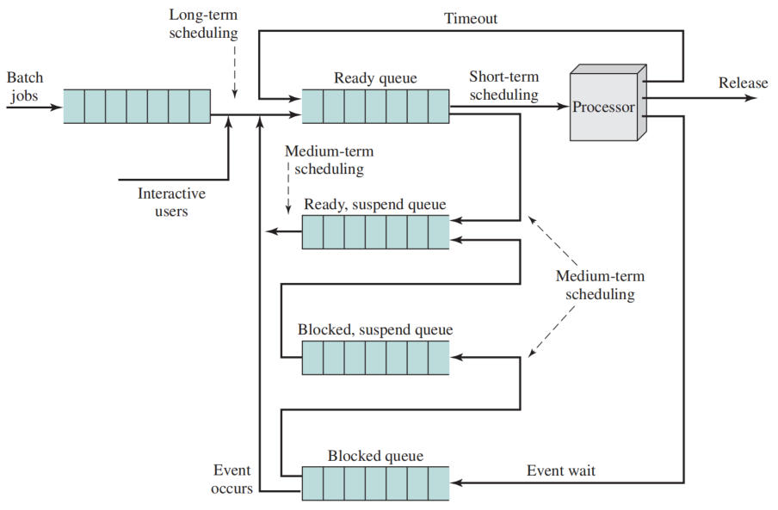
Levels of Scheduling

Slide 3
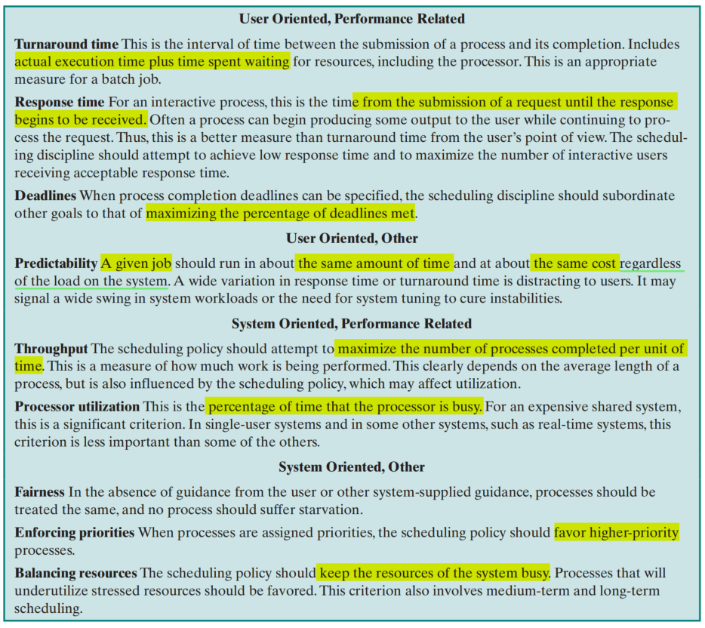
Scheduling Criteria

Slide 4
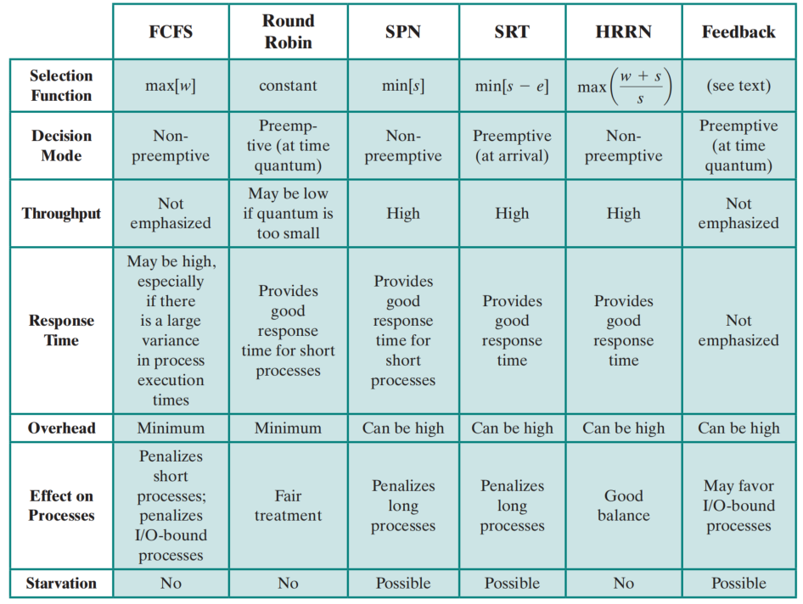
Alternative Scheduling Policies
FCFS: first come first served
RR: Round Robin
SPN: Shortest Process Next
SRT: Shortest Remaining Time
HRRN: Highest Response Ratio Next
FB: Feedback

Slide 5
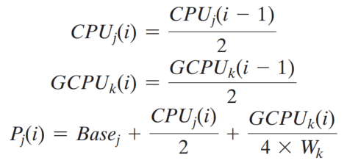
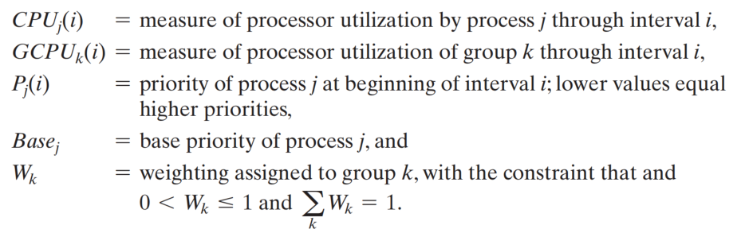
Fair-Share Scheduler (FSS):

Slide 6
Outline
Multiprocessor and Multicore Scheduling
  Granularity
  Design Issues
  Process Scheduling
  Thread Scheduling
  Multicore Thread Scheduling
Real-Time Scheduling
  Background of Real-Time Process
  Characteristics of Real-Time OS
  Real-Time Scheduling
  Deadline Scheduling
  Rate Monotonic Scheduling
  Priority Inversion

Slide 7
1.1 Classifications of Multiprocessor Systems
Loosely coupled or distributed multiprocessor, or cluster
  consists of a collection of relatively autonomous systems, each processor having its own main memory and I/O channels
Functionally specialized processors
  there is a master processor with general-purpose
  specialized processors are controlled by the master processor and provide services to it，such as I/O processor
Tightly coupled multiprocessor
  consists of a set of processors that share a common main memory and are under the integrated control of an operating system

Slide 8
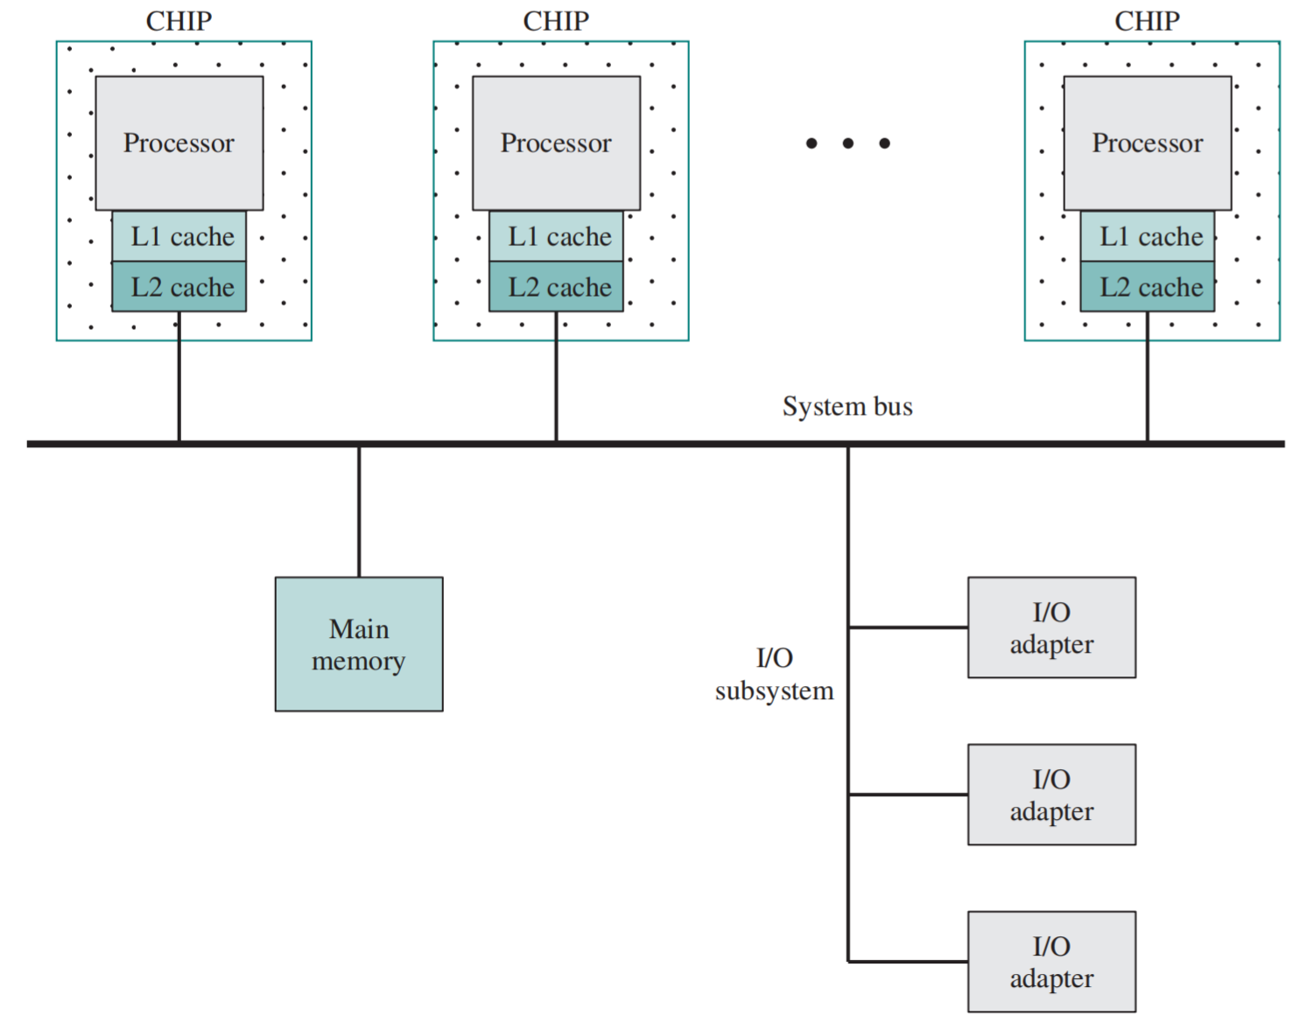
Symmetric Multiprocessor Organization

Slide 9
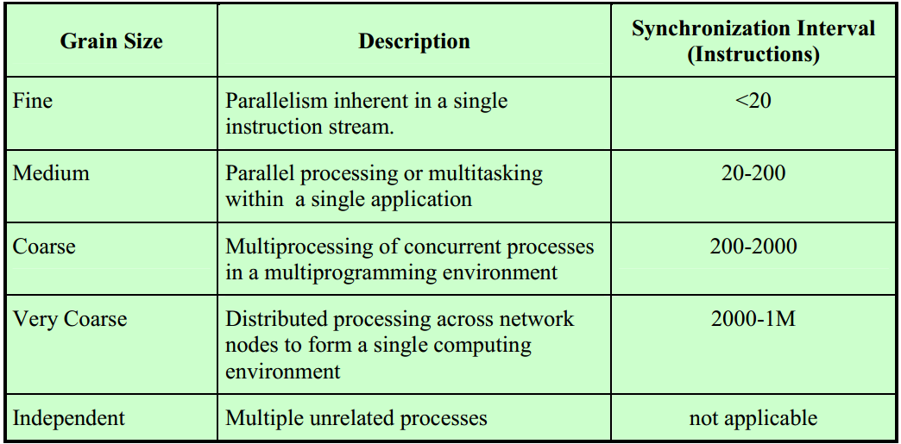
Synchronization Granularity among Processes
Instruction-Level
Thread-Level
Process-Level
Process-Level

Slide 10
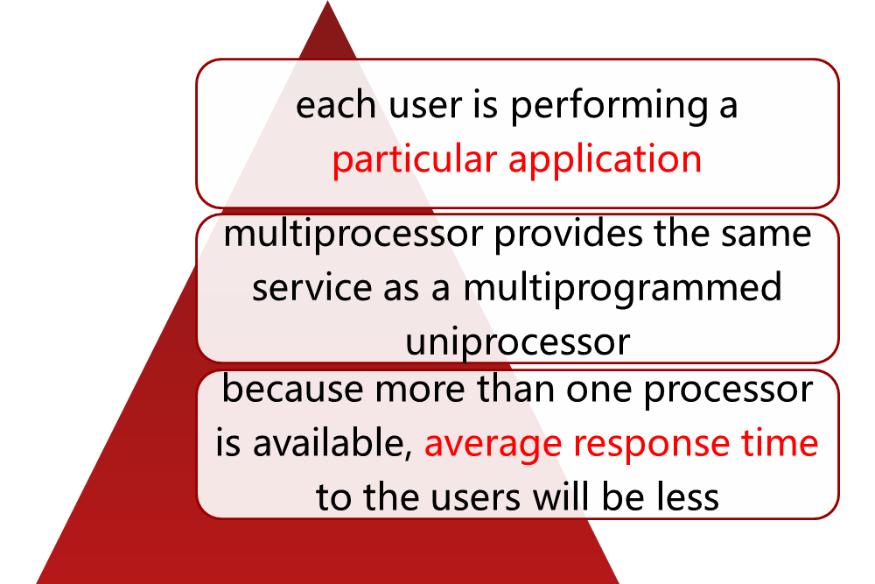
Independent Parallelism
No explicit synchronization among processes
  each represents a separate, independent application
Typical use is in a time-sharing system

Slide 11
Coarse and Very Coarse-Grained Parallelism
Synchronization among processes, but at a very gross level
Good for concurrent processes running on a multi-programmed uniprocessor
  can be supported on a multiprocessor with little or no change to user software
  very infrequent interaction -> a distributed system
  somewhat more frequent -> multiprocessor organization

Slide 12
Medium-Grained Parallelism
Single application can be effectively implemented as a collection of threads within a single process
  programmer must explicitly specify the potential parallelism of an application
  there needs to be a high degree of coordination and interaction among the threads of an application, leading to a medium-grain level of synchronization
Because the various threads of an application interact so frequently, scheduling decisions concerning one thread may affect the performance of the entire application

Slide 13
Fine-Grained Parallelism
Represents a much more complex use of parallelism than threads and processes
Is a specialized and fragmented area with many different approaches

Slide 14
1.2 Design Issues
Scheduling on a multiprocessor involves three interrelated issues:
assignment of processes to processors
actual dispatching of a process
use of multiprogramming on individual processors
The approach is depend on:
  the degree of granularity of applications
  the number of processors available

Slide 15
Assignment of Processes to Processors
Assuming all processors are equal，treat processors as a pooled resource and assign processes to processors on demand
  static
  dynamic

Slide 16
Assignment of Processes to Processors
Static Assignment
  a process is permanently assigned to one processor from activation and its completion.
  Then, a short-term queue is maintained for each processor
  Advantage : less overhead in the scheduling function
  Disadvantage: unbalance load among different processor
  Solution: a common (global) queue can be used
    Process may be executed on different processors
    Due to the shared memory architecture, the context information for all processes will be available to all processors

Slide 17
Assignment of Processes to Processors
Dynamic Load Balancing Assignment
  a short-term queue is maintained for each processor
  Threads/processes are moved from a queue for one processor to a queue for another processor (Push migration or Pull migration)

Slide 18
Assignment of Processes to Processors
Both dynamic and static methods require some way of assigning a process to a processor
  Master/Slave
  Peer (对等)

Slide 19
Master/Slave Architecture
Key kernel functions always run on a particular processor
Master is responsible for scheduling jobs
Slave sends service request to the master
Advantages:
  is simple and requires little enhancement to a uniprocessor multiprogramming operating system
  Conflict resolution is simplified because one processor has control of all memory and I/O resources
Disadvantages:
  failure of master brings down whole system
  master can become a performance bottleneck

Slide 20
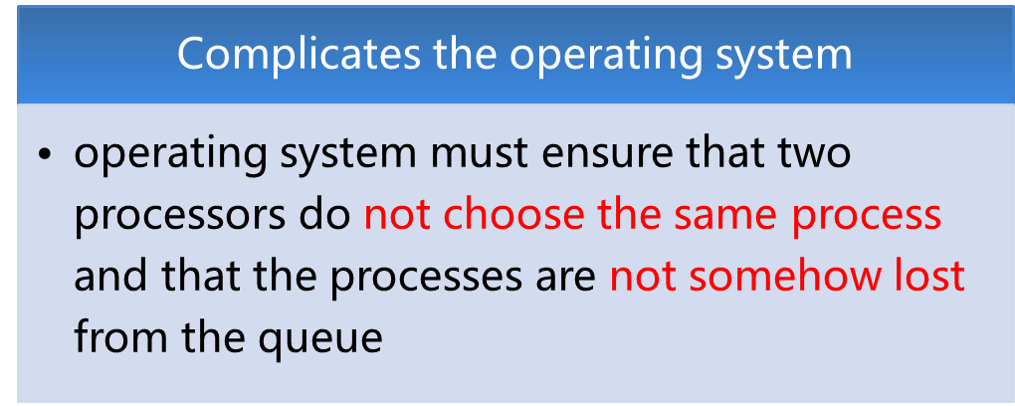
Peer Architecture
Kernel can execute on any processor
Each processor does self-scheduling from the pool of available processes

Slide 21
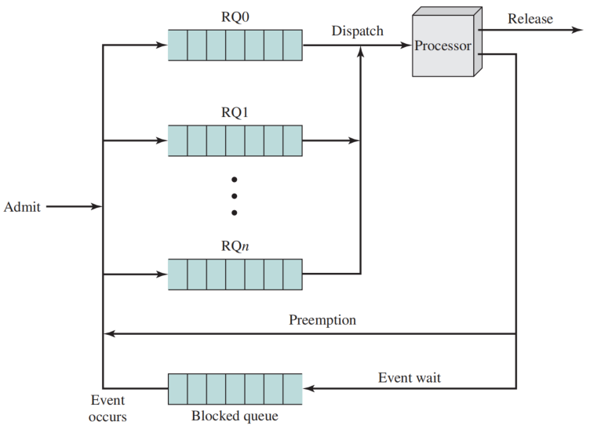
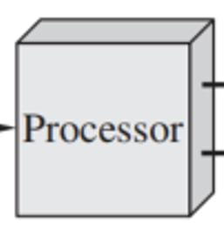
1.3 Process Scheduling in Multiprocessor System
Usually processes are not dedicated to a specific processor
A single queue is used for all processors
  if some sort of priority scheme is used, there are multiple queues based on priority
System is viewed as being a multi-server queuing architecture
…

Slide 22
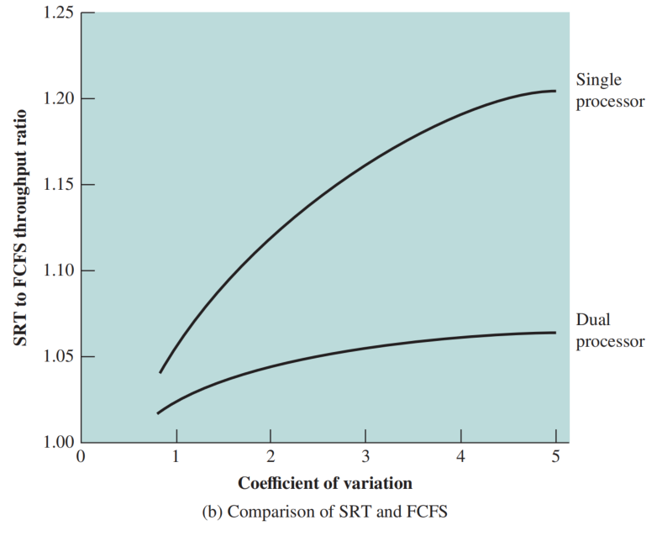
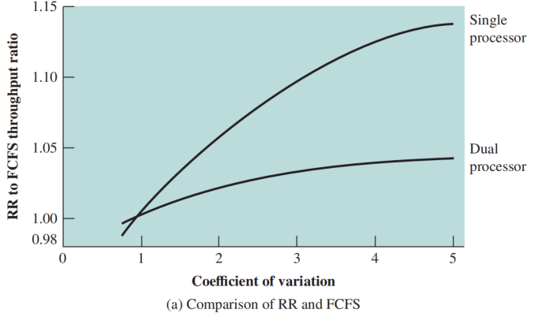
Case of Dual-Processor System
Comparison of scheduling performance
1. Specific scheduling discipline is much less important with two processors than with one.
2. FCFS with a static priority scheme is suffice for MPS
X: the variability of process’s service time

Slide 23
1.4 Thread Scheduling in Multiprocessors
An application can be a set of threads that cooperate and execute concurrently in the same address space
On a uniprocessor
  Threads can be used as a program structuring aid and to overlap I/O with processing (less overhead than process switch)
On a multiprocessor
  enable an application to simultaneously run on separate processors——Dramatic gains brought by multithreads in multiprocessor systems
  require significant interaction among threads
  Small differences in thread management and scheduling can have an impact on applications

Slide 24
Approaches to Thread Scheduling
Four approaches for multiprocessor thread scheduling and processor assignment are:
    Load Sharing
      processes are not assigned to a particular processor
      When idle, each processor selects a thread from the global threads queue
    Gang Scheduling
      a set of related threads scheduled to run on a set of processors at the same time, on a one-to-one basis
    Dedicated （专用） Processor Assignment
      Each program, for the duration of its execution, is allocated a number of processors equal to the number of threads in the program
    Dynamic Scheduling
      the number of threads in a process can be altered during the course of execution

Slide 25
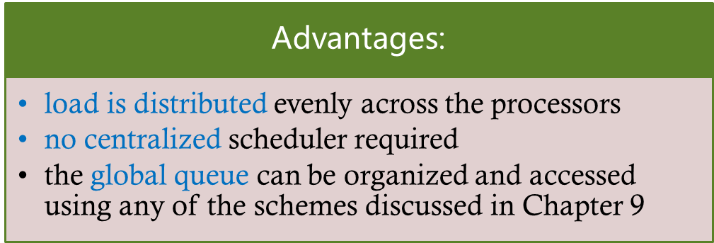
Load Sharing
Simplest approach and carries over most directly from a uniprocessor environment
Versions of load sharing:
  First-come-first-served (FCFS)
  Smallest number of threads first
  preemptive smallest number of threads first

Slide 26
Disadvantages of Load Sharing
Central queue occupies a region of memory
  mutual exclusion access among a large number of processors can lead to bottlenecks
Preemptive threads are likely to resume execution on the different processors
  caching can become less efficient
If all threads are treated as a common pool of threads, all of the threads of a program may not gain access to processors at the same time
  the process switches involved may seriously compromise performance.

Slide 27
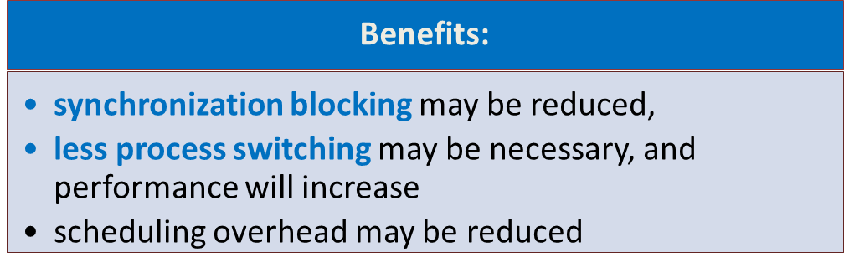
Gang Scheduling
Simultaneous scheduling of the threads that make up a single process
Useful for medium-grained to fine-grained parallel applications whose performance severely degrades when any part of the application is not running while other parts are ready to run
Beneficial for any parallel application

Slide 28
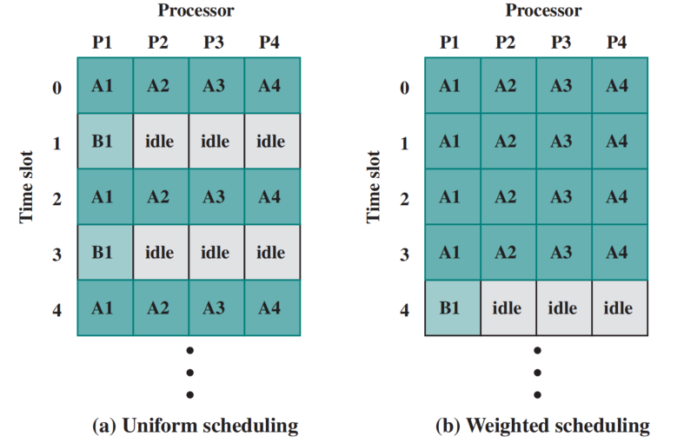
Example of Gang Scheduling
The use of gang scheduling creates a requirement for processor allocation
N processors
M applications,
Each application could be given 1/M times
37.5% idle
15% idle
Example of scheduling groups with four and one threads

Slide 29
Dedicated Processor Assignment
When an application is scheduled, each of its threads is assigned to a processor that remains dedicated to that thread until the application runs to completion
If a thread of an application is blocked waiting for I/O or for synchronization with another thread, then that thread’s processor remains idle
  there is no multiprogramming of processors
Defense of this strategy:
  in a highly parallel system, with tens or hundreds of processors, processor utilization is no longer so important as a metric for effectiveness or performance
  the total avoidance of process switching during the lifetime of a program should result in a substantial speedup of that program

Slide 30

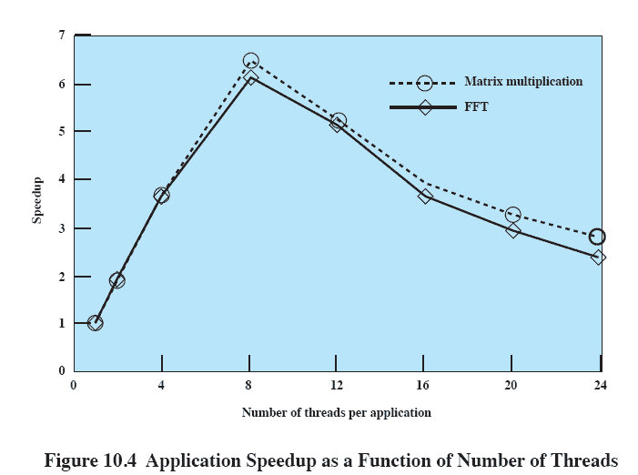
Application Speedup as a Function of Number of Threads
Why it degrades after 8 threads with 16 processors
A greater frequency of thread preemption and rescheduling results in inefficiency from many sources
  waiting time for a suspended thread
  Time wasted in process switching
  inefficient cache behavior.

Slide 31
Dynamic Scheduling
Some applications provide language and system tools to change the number of threads of process dynamically
  this would allow the operating system to adjust the load to improve utilization
Both the operating system and the application are involved in making scheduling decisions
  The operating system: allocating the processors to the jobs
  Individual application:
    Map tasks to threads
    Determine which subset to run, and which thread to suspend when a process is preempted

Slide 32
2 Real-Time Systems
The scheduler, is perhaps the most important component in Real-Time System
Real-time computing: Correctness of the system depends on both the logical result of the computation and on the complete time.
Real-time system:
  some of the tasks are real-time tasks, and these have a certain degree of urgency to them.
  Such tasks are attempting to control or react to events that take place in the outside world.
  Associate a deadline with a particular task

Slide 33
Hard and Soft Real-Time Tasks
Hard real-time task
  one that must meet its deadline
  otherwise it will cause unacceptable damage or a fatal error to the system
Soft real-time task
  Has an associated deadline that is desirable but not mandatory(不强制的)
  It still makes sense to schedule and complete the task even if it has passed its deadline

Slide 34
Another characteristic of real-time tasks
Periodic tasks
  requirement may be stated as:
    once per period T
    exactly T units apart
Aperiodic tasks
  has a deadline by which it must finish or start
  may have a constraint on both start and finish time

Slide 35
2.1 Characteristics of Real Time Systems
Real-time operating systems have requirements in five general areas:
  Determinism（确定性）
  Responsiveness（响应性）
  User control
  Reliability（可靠性）
  Fail-soft operation（故障弱化）

Slide 36
Determinism（可确定性）
Determinism means that operations are performed at fixed, predetermined times or within predetermined time intervals
  when multiple processes are competing for resources and processor time, no system will be fully deterministic
The extent to which an operating system can deterministically satisfy requests depends on:
  the speed with which it can respond to interrupts
  whether the system has sufficient capacity to handle all requests within the required time

Slide 37
Responsiveness（可响应性）
Concerned with how long it takes an operating system to service the interrupt
Responsiveness includes:
  amount of time required to initially handle the interrupt and begin execution of the interrupt service routine (ISR)
  amount of time required to perform the ISR
  effect of interrupt nesting (嵌套)
Together with determinism make up the response time to external events

Slide 38
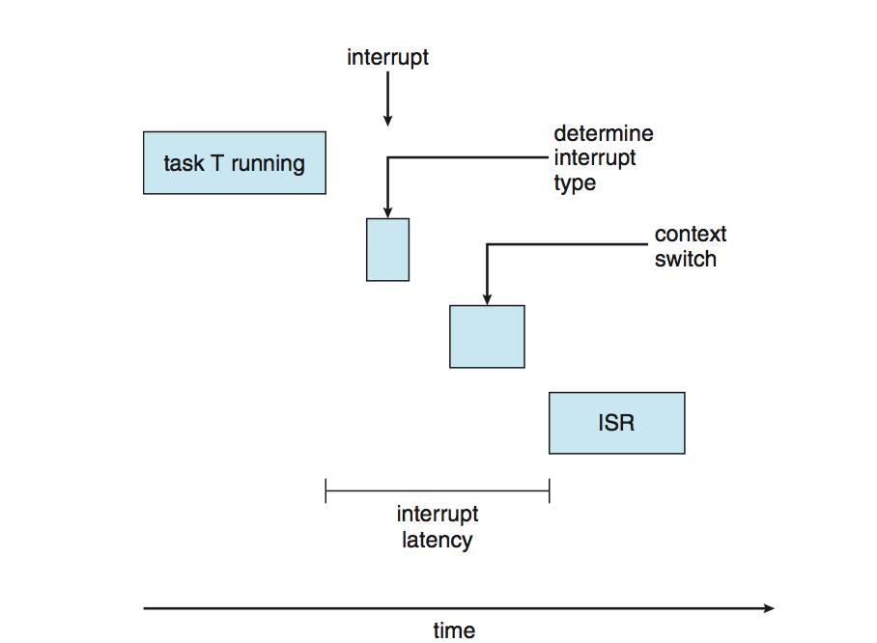
Interrupt

Slide 39
User Control
Generally much broader in a real-time operating system than in ordinary operating systems
It is essential to allow the user fine-grained control over task priority
User should be able to distinguish between hard and soft real-time tasks and to specify relative priorities within each class
May allow user to specify such characteristics as:
  paging or process swapping
  what processes must always be resident in main memory
  what disk transfer algorithms are to be used
  what rights the processes in various priority bands have

Slide 40
Reliability（可靠性）
More important for real-time systems than non-real time systems
Real-time systems respond to and control events in real time so loss or degradation of performance may have catastrophic consequences such as:
  financial loss
  major equipment damage
  loss of life

Slide 41
Fail-Soft Operation（故障弱化操作）
A characteristic that refers to the ability of a system to fail in such a way as to preserve as much capability and data as possible
Important aspect is stability
  a real-time system is stable if the system will meet the deadlines of its most critical, highest-priority tasks even if some less critical task deadlines are not always met

Slide 42
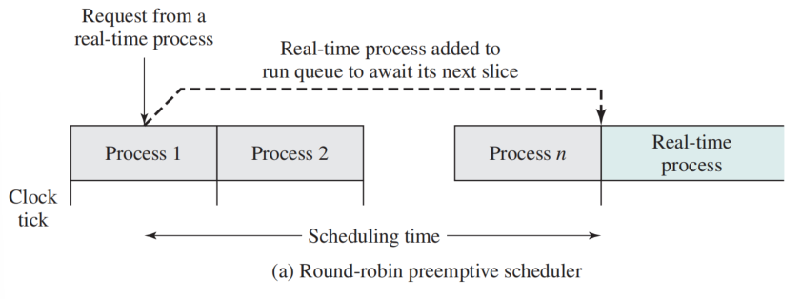
2.2 Scheduling of Real-Time Process

Slide 43
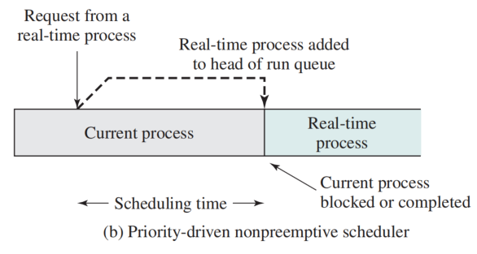
Scheduling of Real-Time Process

Slide 44
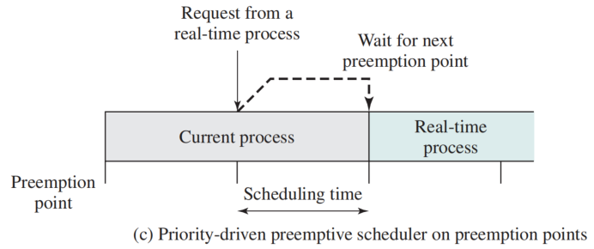
Scheduling of Real-Time Process

Slide 45
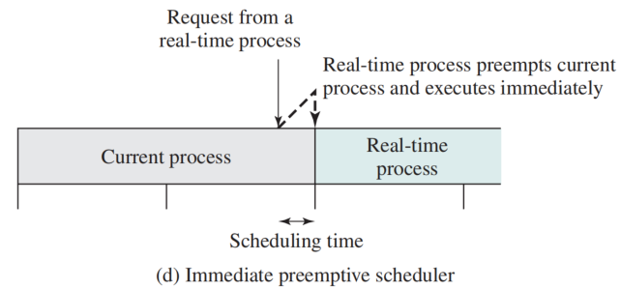
Scheduling of Real-Time Process

Slide 46
Real-Time Scheduling
Scheduling approaches depend on:
  whether a system performs schedulability analysis
  if it does, whether it is done statically or dynamically
  whether the result of the analysis itself produces a scheduler plan according to which tasks are dispatched at run time

Slide 47
Classes of Real-Time Scheduling Algorithms
Static table-driven approaches (periodic)
  performs a static analysis of feasible schedules of dispatching
  result is a schedule that determines when a task must begin execution
Static priority-driven preemptive approaches
  a static analysis is performed but no schedule is drawn up
  analysis is used to assign priorities to tasks so that a traditional priority-driven preemptive scheduler can be used

Slide 48
Classes of Real-Time Scheduling Algorithms
Dynamic planning-based approaches
  feasibility is determined at run time rather than offline prior to the start of execution
  one result of the analysis is a schedule that is used to decide when to dispatch this task
Dynamic best effort approaches
  no feasibility analysis is performed
  system tries to meet all deadlines and aborts any started process whose deadline is missed

Slide 49
Deadline Scheduling
Real-time operating systems are designed with the objective of starting real-time tasks as rapidly as possible and OS emphasizes rapid interrupt handling and task dispatching
Real-time applications are generally not concerned with sheer speed but rather with completing tasks at the most valuable times
Priorities provide a crude tool and do not capture the requirement of completion at the most valuable time

Slide 50
Information Used for Deadline Scheduling
Ready time
  time task becomes ready for execution
Starting deadline
  time task must begin
Completion deadline
  time task must be completed
Processing time
  time required to execute the task to completion
Resource requirements
  resources required by the task while it is executing
Priority
  measures relative importance of the task
Subtask structure
  a task may be decomposed into a mandatory subtask and an optional subtask
  Only the mandatory subtask possesses a hard deadline.

Slide 51
Critic Design Issues of Real-Time Scheduling
When deadline is considered:
  Which task to schedule next, and what kind of preemption is allowed.
For a given preemption strategy
  Using starting or completion deadlines to decide which task
The other critical design issue is that of preemption.
  When starting deadlines are specified, then a non-preemptive scheduler makes sense. (need to block itself)
  For a system with completion deadlines, a preemptive strategy is most appropriate.

Slide 52
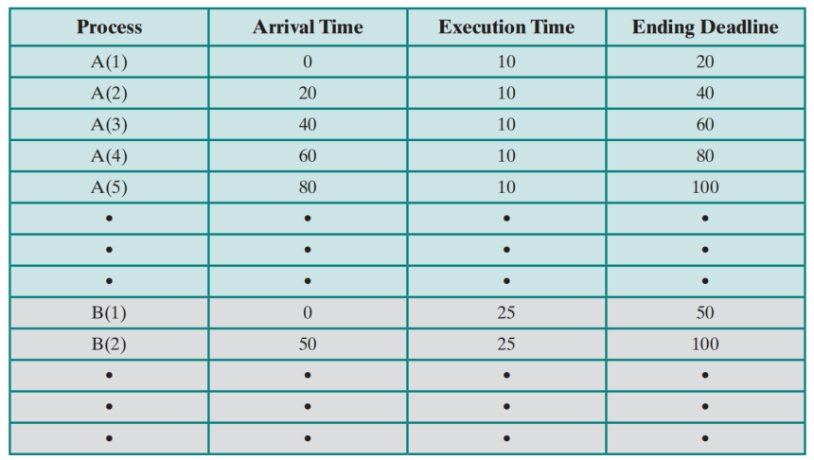
Table 10.2 Execution Profile of Two Periodic Tasks

Slide 53
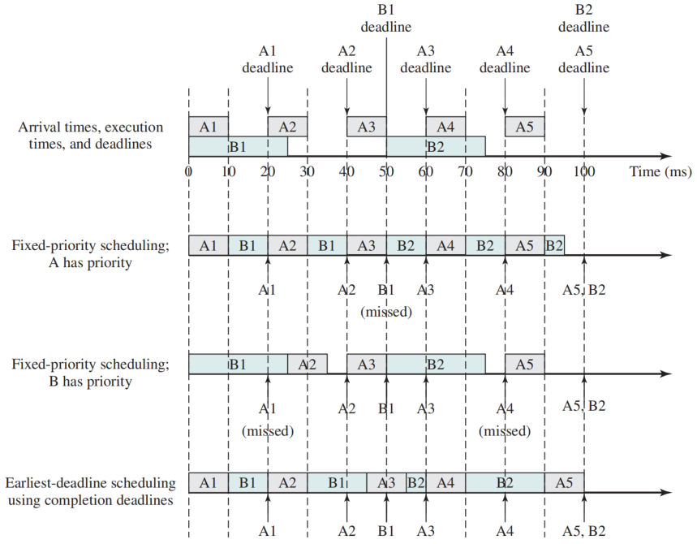
Scheduling of Periodic Real-Time Tasks with Completion Deadlines
Preemption
Figure 10.5 Scheduling of Periodic Real-Time Tasks with Completion Deadlines

Slide 54
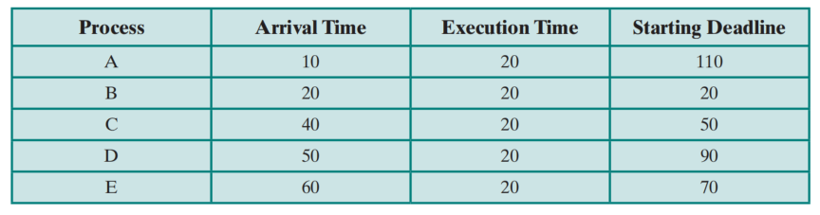
Table 10.3 Execution Profile of Five Aperiodic Tasks

Slide 55
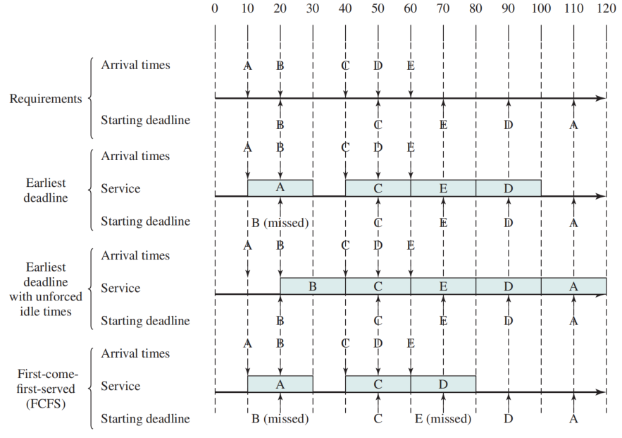
Scheduling of Aperiodic Real-Time Tasks with Starting Deadlines
Non-Preemption
Figure 10.6 Scheduling of Aperiodic Real-Time Tasks with Starting Deadlines

Slide 56
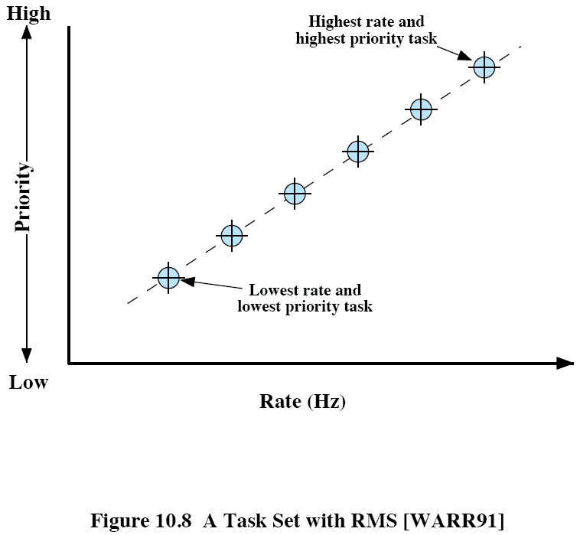
Rate Monotonic Scheduling （RMS）
the highest-priority task is the one with the shortest period
T: Task’s Period (second)
Rate = 1/T (Hz)
  T=50ms
  Rate = 1/0.05=20 Hz
Priority is monotonically increasing with respect to rate

Slide 57
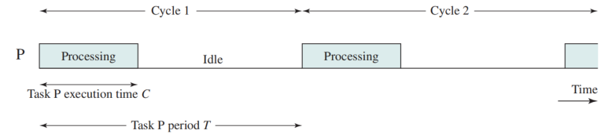
Periodic Task Timing Diagram
C: execution time
T: period
U = C/T: processor utilization

Slide 58
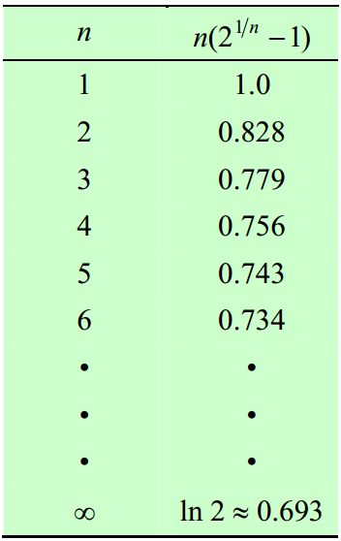
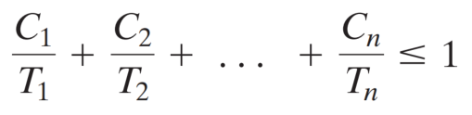

Measure of Periodic Scheduling Algorithm
If a perfect scheduling algorithm can successfully schedule, a bound of number of tasks is
Any particular algorithm, bound may be lower:

Slide 59
RMS

Slide 60
Priority Inversion
Occurs when circumstances within the system force a higher priority task to wait for a lower priority task
  Can occur in any priority-based preemptive scheduling scheme
  Particularly relevant in the context of real-time scheduling
Best-known instance involved the Mars Pathfinder mission
More serious case: unbounded Priority Inversion
  the duration of a priority inversion depends not only on the time required to handle a shared resource, but also on the unpredictable actions of other unrelated tasks

Slide 61
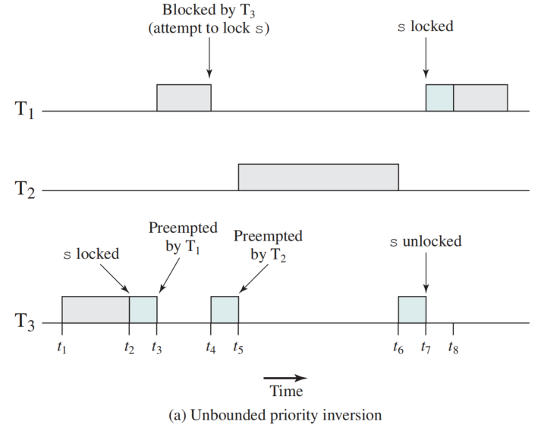
Unbounded Priority Inversion
Priority T1>T2>T3

Slide 62
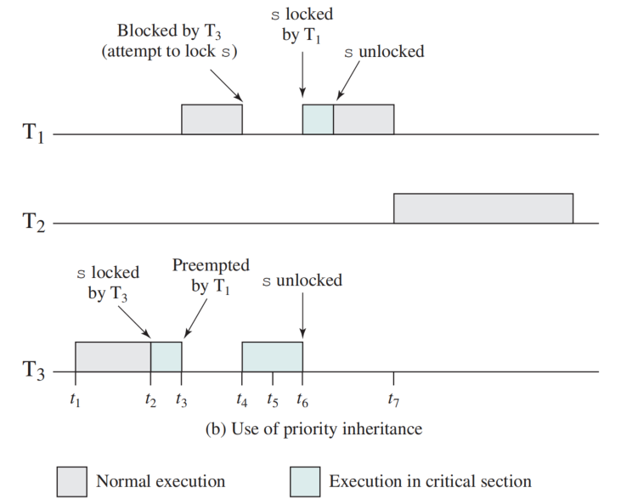
Priority Inheritance （继承）
a lower-priority task inherits the priority of any higher-priority task pending on a resource they share.

Slide 63
Summary
With a tightly coupled multiprocessor, multiple processors have access to the same main memory
Performance studies suggest that the differences among various scheduling algorithms are less significant in a multiprocessor system
A real-time process is one that is executed in connection with some process or function or set of events external to the computer system and that must meet one or more deadlines to interact effectively and correctly with the external environment
A real-time operating system is one that is capable of managing real-time processes
Key factor is the meeting of deadlines
Algorithms that rely heavily on preemption and on reacting to relative deadlines are appropriate in this context

Slide 64
Quiz
Consider a set of three periodic tasks with the execution profiles of Table 10.7. Develop scheduling diagrams similar to those of Figure 10.5 for this set of tasks.

Slide 65
Quiz
Consider a set of five aperiodic tasks with the execution profiles of Table 10.8. Develop scheduling diagrams similar to those of Figure 10.6 for this set of tasks

Slide 66
Quiz
A system is predominated by periodic tasks and so rate monotonic scheduling (RMS) is proposed as a way to resolve multitask scheduling conflicts. Assume that in a given time span the system has five tasks with parameters as listed below:
  • Task P1: Processing Time C1 = 20; Period T1 = 90
  • Task P2: Processing Time C2 = 30; Period T2 = 250
  • Task P3: Processing Time C3 = 70; Period T3 = 370
  • Task P4: Processing Time C4 = 50; Period T4 = 330
  • Task P5: Processing Time C5 = 125; Period T5 = 2000
We have seen that Equation (10.2) provides an upper bound on the number of tasks that a perfect scheduling algorithm can successfully schedule. If RMS is used, analyze whether the tasks can be successfully scheduled as per Equation (10.2).

